Slide 1
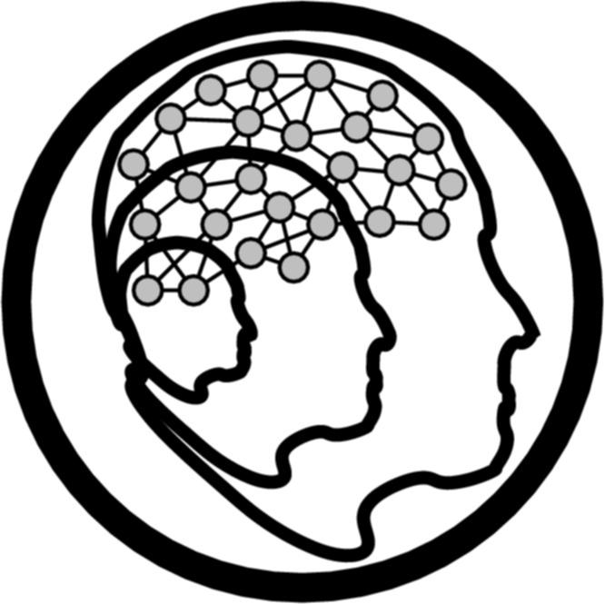
An Introduction to Contextualized Teaching and Learning:
A way to teach content through relevant materials that keeps students engaged and learning
Marlene A. Bumgarner, Ed.D.
July 14, 2017
Gavilan College Teaching & Learning Center

Slide 2

What is Contextual Learning?
Contextual Learning is an instructional strategy that:
Actively involves the learner in the learning process
Combines content and context; all learning is applied knowledge
Employs authentic materials and authentic assessment

Slide 3
The Theory Behind CTL
Contextual learning is rooted in a constructivist approach to teaching and learning.
Constructivist theory is usually associated with cognitive psychologist Jean Piaget.
He believed that we learn concepts and construct construct meaning through interacting with and interpreting events in our environment.
The application of contextual learning to American classrooms was first proposed by John Dewey.

Slide 4
Value of Contextualized Teaching
Contextualized Teaching is a “diverse family of instructional strategies designed to more seamlessly link the learning of foundational skills and academic or occupational content by focusing teaching and learning squarely on concrete applications in a specific context that is of interest to the student”
Notes:
Chris Mazzeo (2008) Mazzeo, C. (2008). Supporting student success at California community colleges. Prepared for the Bay Area Workforce Funding Collaborative Career by the Career Ladders Project for California Community Colleges.

Slide 5

How Does CTL Work?
According to constructivist theory, learning occurs when students (learners) process new information or knowledge in such a way that it makes sense to them in their own frames of reference (their own inner worlds of memory, experience, and response).
This approach to learning and teaching assumes that the mind naturally seeks meaning in context, that is, in relation to the person's current environment, and that it does so by searching for relationships that make sense and appear useful.

Slide 6
Value of Contextualized Teaching
Students learn more effectively when they:
Search for meaning in their own learning process
Use real-life resources to gather information
Integrate new knowledge and skills into already existing knowledge
See content and context together
Learn to solve problems in new ways

Slide 7

Characteristics of Contextualized Learning
Application-oriented
Learner-centered
Abstract ideas presented through the senses
Goals and purpose are explicit
Personally meaningful

Slide 8
Why Do Gavilan Students Need CTL? Do the Math
100 students start three levels below college level
75% pass the first course (75 students)
75% enroll in the next course (56 students)
75% pass the second course (42 students)
75% enroll in next level (32 students)
75% pass that course (24 students)
75% enroll in next level (18 students)
75% pass the college level course (13 students)
Notes:
Hern & Snell, 2010: Chapter 3: California Acceleration Project: Redesigning Developmental Education to Increase Student Completion of College-Level Math and English . IN New Directions in Community Colleges, edited by Katherine Hughes and Andrea Venezia (Jossey-Bass, 2014)]

Slide 9
Students are Unprepared for College Work
Nationally 60% of community college students enroll in at least one developmental course
In California, more than one in three enrolls in a basic skills class
If there were a mandatory assessment and placement policy, this number would be much higher
As it is, many of the students in regular college classes should be in developmental courses

Slide 10
Students Unprepared for 21st Century Workforce
Changing workforce expectations demand more “middle-skills workers,” employees who
Have current technical knowledge
Communicate well
Think critically
Learn quickly
Workforce Alliance data indicate middle-skill jobs account for nearly half of the labor market in the California economy

Slide 11
From the Sage on the Stage to the Guide on the Side
CTL requires a shift in classroom dynamics
Traditional classroom instruction:
Instructor plays an active role, lecturing, etc.
Student’s role is passive
Contextualized teaching:
The learner becomes the constructor of meaning
Instructor’s job is to create conditions that support student engagement in the learning process

Slide 12
Teaching Concepts in Context
Makes learning relevant
Engages and motivates hard-to-reach students
Increases learner confidence & enthusiasm
Enhances interest in long-term goals and education
Many people learn better and faster, and retain information longer, when they are taught concepts in context

Slide 13
Different ways to accomplish CTL
Infused academic courses
Infused occupational courses
Linked courses
Team teaching of integrated academic and occupational courses

Slide 14
Contextualized Learning in the CCCs
Students in contextual math compared to standard math classes:
327% more likely to pass contextual course
387% more likely to pass degree applicable course in the same semester
400% more likely to pass transfer-level course in the same semester

Slide 15
Examples of Contextualized Teaching and Learning
Daniel Keller, College of San Mateo (CSM) - Infused academic course: intensive composition and reading course one level below transfer; incorporates service learning
Phillip Sutton and Roberto Pandol, El Camino College - Infused occupational course: basic skills math integrated with statistical process control (SPC) implemented by front-line workers at microelectronics manufacturing company.
Myra Snell, Los Medanos College – Infused academic course: elementary and intermediate algebra courses taught using real-world context.
Scott Sandler, Gavilan College – linked English 250 and Child Development
Notes:
Source: Faculty Primer.

Slide 16
Benefits of Contextualized Instruction to the Learner
The purpose of learning is explicit (top down rather than bottom up)
Learners build on previous knowledge
Learning impacts real life
Learners learn to solve problems that can be used in the real world
Learners control their learning process by their rate of participation
Transference of knowledge is explicit and immediately recognizable

Slide 17

Benefits of Contextualized Learning to the Instructor
Knowledge retention increases
Student motivation increases
Instructor guides the learning process
Learning is a team effort, encouraging student persistence
Learning is the student’s responsibility, not the instructor’s

Slide 18
Contextualized Teaching and Learning is a win/win situation for the learner and the instructor

